Slide 1
A Brief Intro to CASMO
Tracey Spoerer
March 4th, 2024

Slide 2

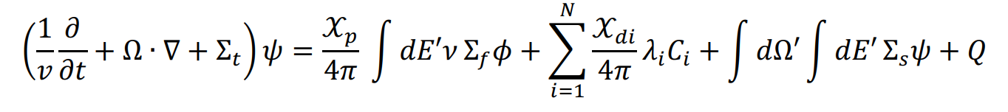
Hello old friend…
How to solve? Analytical solutions are difficult even in simple geometries with monoenergetic simplification.
(me all day, everyday…)

Slide 3
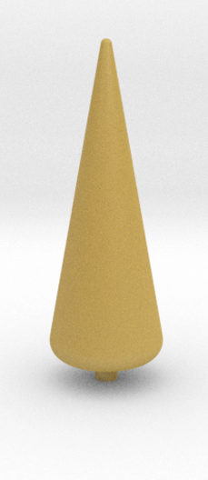
Diffusion Theory
Fick’s law → particles will diffuse from the region of higher flux to the region of lower flux through collisions.
Neutron flux is assumed to be isotropic, proximity to strong sources or absorbers or any strongly an-isotropic materials invalidates the original derivations.
This invalidation also includes proximity to any strongly varying material interfaces or boundaries.
Fick’s law assumes flux is independent of time. Rapid time-varying flux changes not valid.
Many of these approximations are not applicable for weapons work.
(spicy cone)

Slide 4
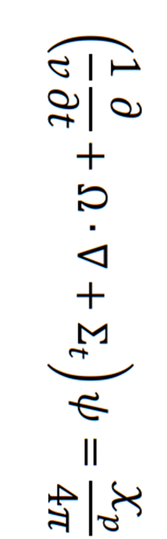

Monte Carlo
Idea: don’t solve Boltzmann Equation. Play a game called “follow the neutron.”
Stochastic method (Monte Carlo).
Discrete particle histories are tracked and averaged in a random walk determined by interaction probabilities.
(Maybe don’t tell neutronics faculty I showed you that)

Slide 5
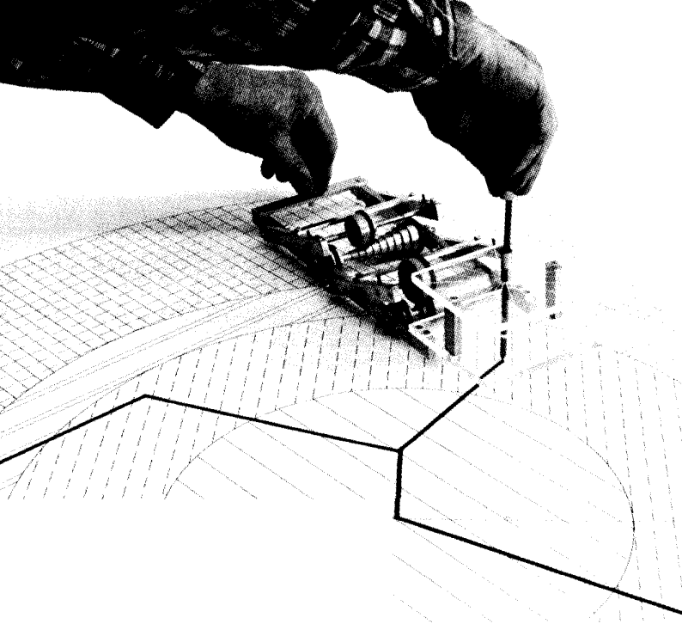
Monte Carlo
Average particle behavior in very complex and/or accurate geometries can be captured.
Particle energy (and other variables) can be continuous.
Is computationally expensive (i.e., slow).

Slide 6
Another option…
We can solve this using numerical methods if variables such as angle and energy are discretized.

Slide 7
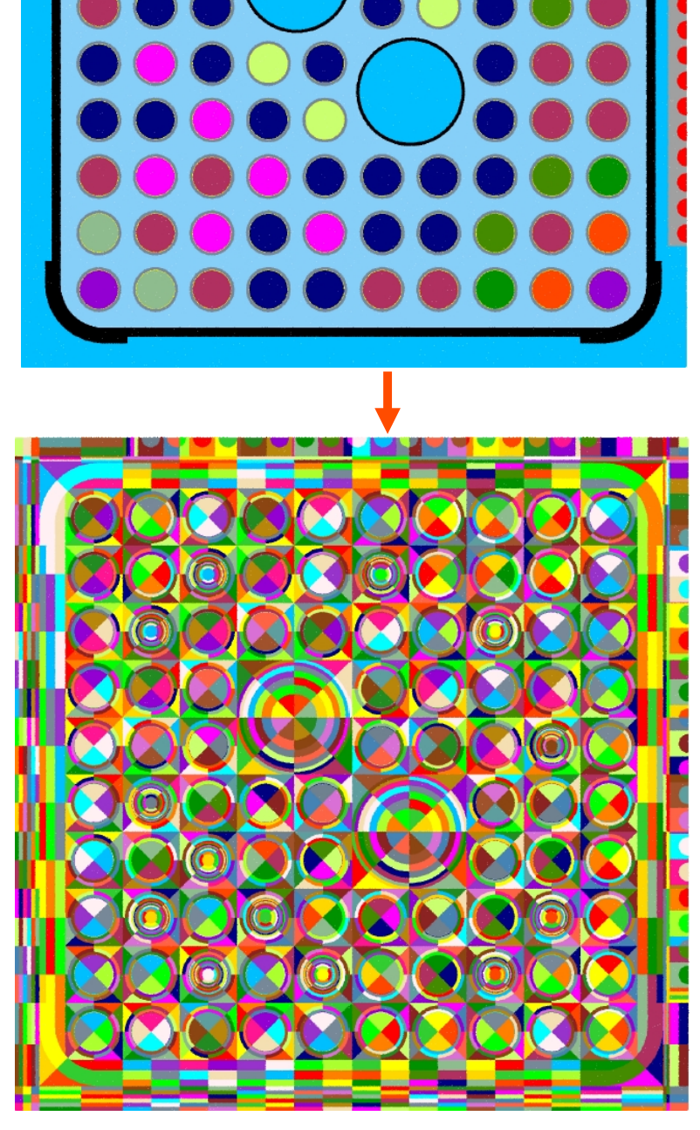
Deterministic Methods
Spatial variables are typically discretized by simply breaking the geometry into many small regions on a mesh.
The balance can then be solved at each mesh point using finite difference or by nodal methods.
Angular variables can be discretized by discrete ordinates and weighting quadrature sets (giving rise to the S_{N} methods), or by functional expansion methods with the spherical harmonics (leading to the P_{N} methods).
Energy variables are typically discretized by the multi-group method.
Many lattice physics codes are deterministic.
(not spicy cone)

Slide 8
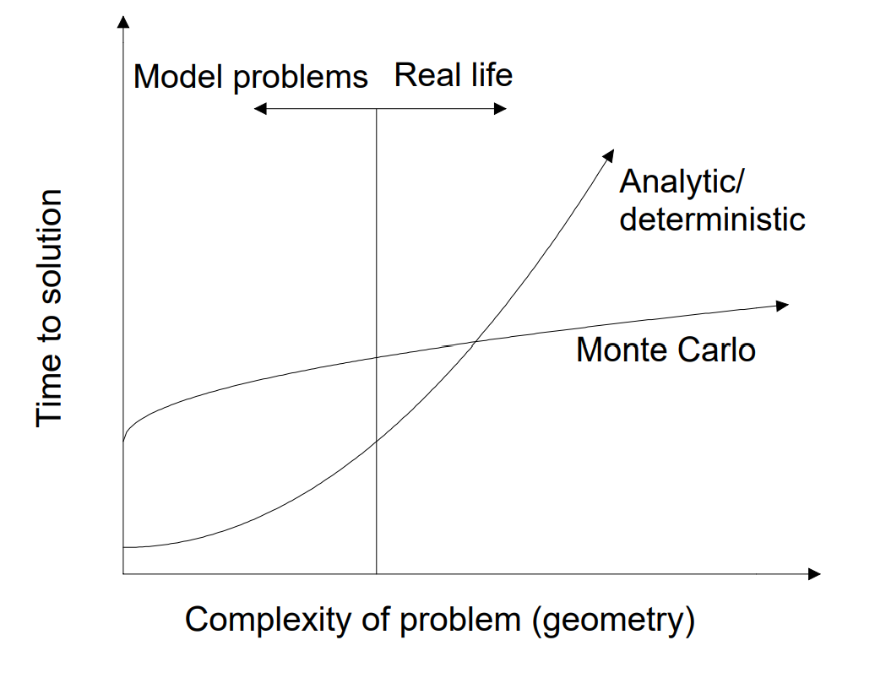
Monte Carlo vs. Deterministic
Monte Carlo provides a “statistically-approximate solution to specific regions of a problem to an exact equation.”
Whereas deterministic provides “exact solutions everywhere in a problem to an approximate and discretized equation.”
Availability of computing power (or urgency of answer, time = $) drives choice of method and definition of “what is good enough” for accuracy.

Slide 9
Homogenization
Some of the pitfalls of approaches like diffusion can be negated by assuming the reactor is all one homogenized material.
In others, the computational expense of explicit geometrical modeling can be reduced by coupling geometrically-simple, energy-intensive calculations with few-group, geometrically-complicated calculations.
Pin cell transport spectral calculations (whose geometry consists of fuel pin, clad, coolant, and buffer material) are performed in 1-dimensional cylindrical geometry with 20-100 energy groups. The resultant neutron spectrum is used to collapse cross sections to 6-20 groups.
Collapsed pin cell cross sections are used in assembly transport calculations.

Slide 10
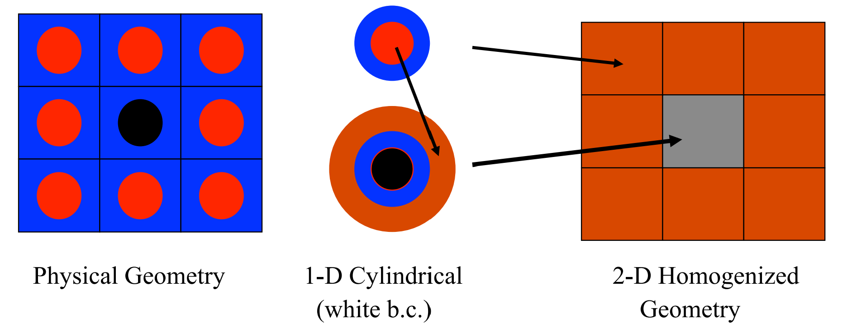
Homogenization

Slide 11
CASMO 4
CASMO 4 is a deterministic lattice physics code developed by Studsvik for BWR and PWR fuel assembly burnup calculations.
A lattice model means to discretize space into a lattice or mesh rather than a continuum.
CASMO uses method of characteristics and up to 586 energy groups.

Slide 12

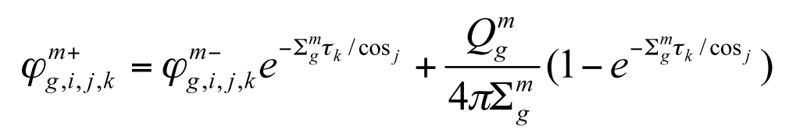
Method of Characteristics
Reduces partial differential equation to a family of ordinary differential equations.
Widely used in reactor fuel lattice calculations because of its high adaptability for unstructured meshes.
Unstructured meshes are meshes with general connectivity whose structure is arbitrary.

Slide 13
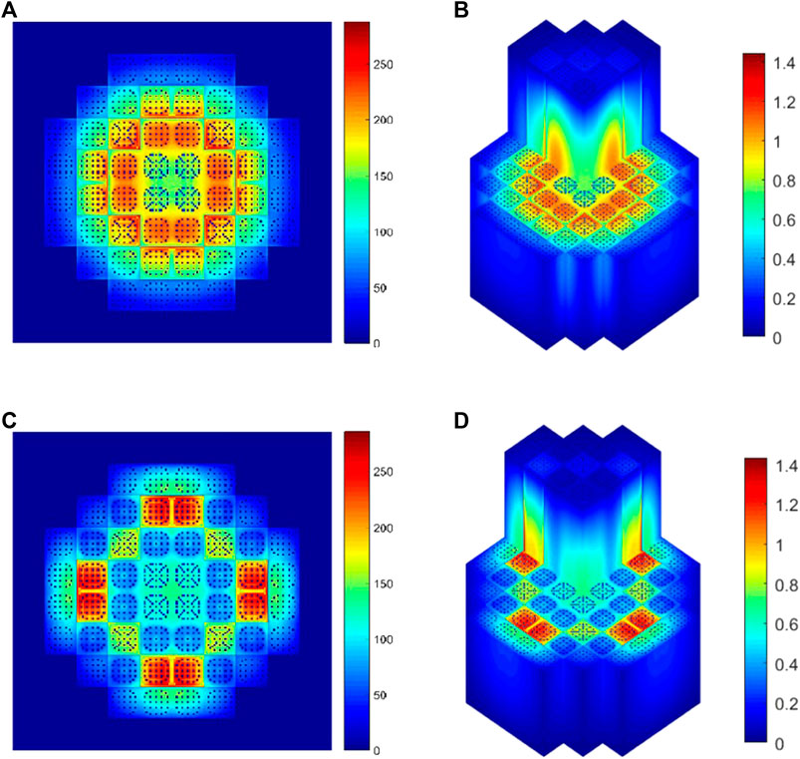
CASMO 4
Power-Per-Pin analysis
Power-Per-Assembly analysis
Burnup calculations
Core shuffle planning and power peaking

Slide 14
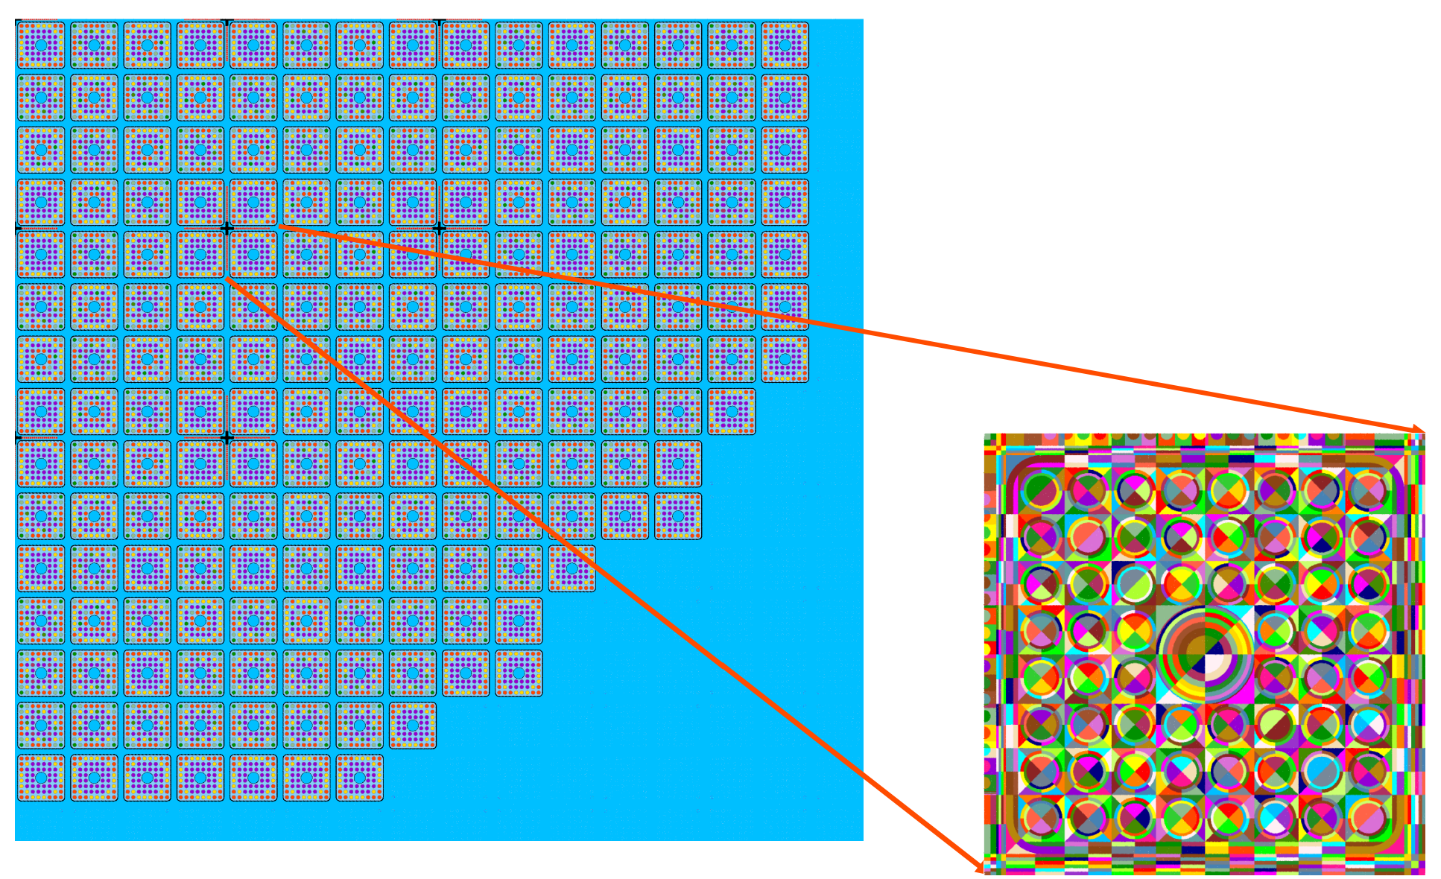
Fuel Loading Schemes (D&H pg. 599)
All Fresh Load
Scatter Loading
Zonal Loading
Combination Zonal/Scatter Loading

Slide 15
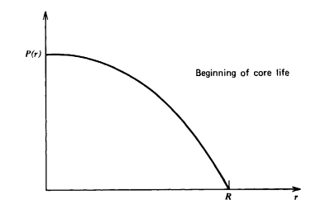
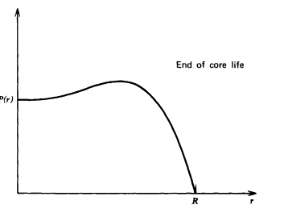
Burnup

Slide 16
CASMO Project
Study effects of different core loading schemes on power distribution.
Sample input given with 3 different enrichments, change assembly layouts.
Plot power profiles and comment on implications for reactor performance.

Slide 17
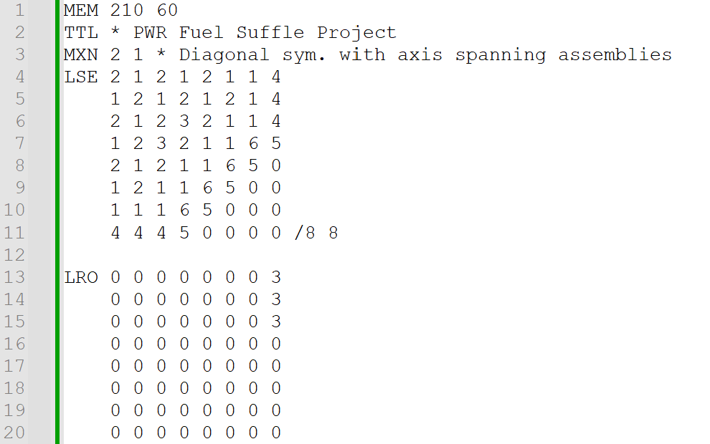
Input

Slide 18
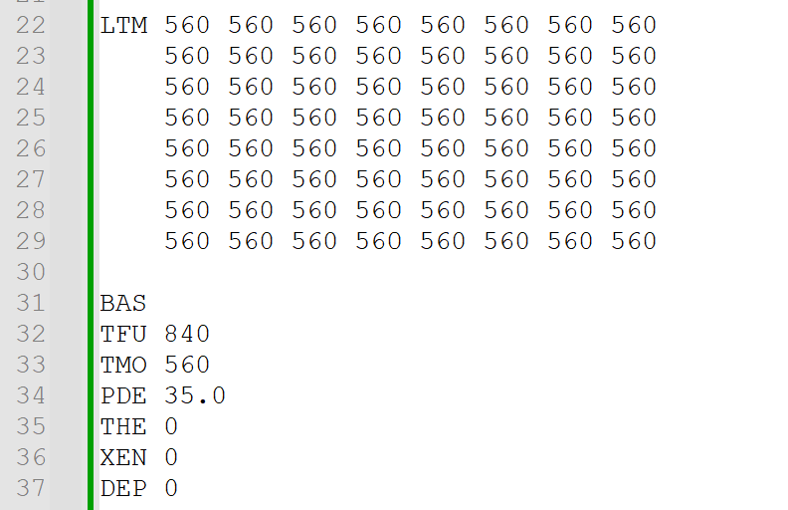
Input

Slide 19
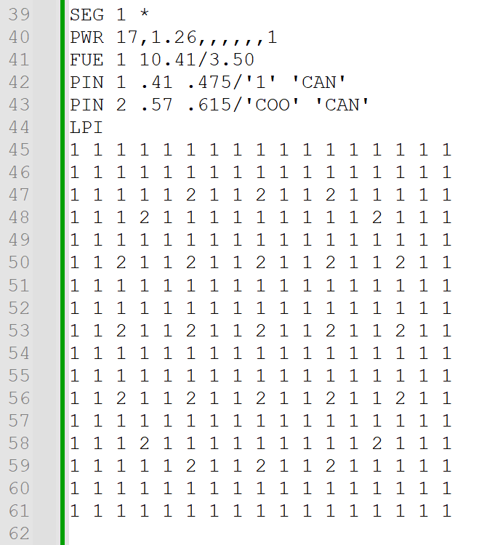
Input

Slide 20
Inputs
LSE → Layout of segments (assemblies) / MxN system.
LRO → Rotation map, 0 = 0°, 1 = 90°, 2 = 180°, 3 = 270°.
LTM → Moderator temperature map, /EXP1 EXP2 are exposures in MWd/kg (not needed).

Slide 21
Inputs
BAS → Base segment data. Data common to all segments follows the BAS card.
PDE → Power density (MW/kg, assume 35).
TFU → Fuel temperature in Kelvin (assume 840).

Slide 22
Inputs
TMO → Moderator-cladding interface temperature in Kelvin (assume 560).
THE → Thermal expansion card (assume zero).
DEP → Cycle exposure/depletion (assume zero).
S3I → Generate equivalent SIMULATE input (not need).

Slide 23
Inputs
XEN → Xenon concentration perhaps… Assume zero.
PVD → Boron burnup (leave out).

